Slide 1
DigData – Excel Cheat Sheet
02 May 2023
NEXT STEP

Slide 2
The below data is included in the example spreadsheet to follow along if you’d like
Class | ID | Name | Gender | Attendance | Revised | Science | Maths1 | Maths2
Class A | 1 | Tom | X | Good | TRUE | 98 | 80 | 81
Class A | 2 | Ben | M | Satisfactory | TRUE | 72 | 81 | 76
Class A | 3 | Lily | F | Good | TRUE | -84 | 92 | 88
Class A | 4 | Ivy | F | Good | TRUE | 910 | 78 | 74
Class A | 5 | Alex | M | Good | TRUE | 77 | 76 | 83
Class A | 6 | Oliver | M | Satisfactory | TRUE | #N/A | 85 | 82
Class B | 7 | Hazel | F | Good | FALSE | 81 | 83 | 87
Class B | 8 | Emily | F | Poor | TRUE | 85 | 83 | 91
Class B | 9 | John | M | Great | TRUE | 95 | 91 | 87
Class B | 10 | James | M | Poor | FALSE | 73 | 88 | 80
Class B | 11 | Anna | F | Great | TRUE | 96 | 89 | 85
Class B | 12 | Rose | F | Good | TRUE | 90 | 77 | 79
Class B | 12 | Rose | F | Good | TRUE | 90 | 77 | 79

Slide 3



DigData – Summary Statistics
NEXT STEP

Slide 4
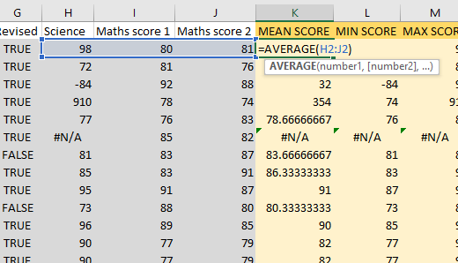
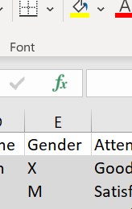
STATS
STAT | Function
COUNT | COUNT(value1, [value2], …)
COUNTIF | COUNTIFS(criteria_range1, criteria1, [criteria_range2, criteria2]…)
MEAN | AVERAGE(number1, [number2], …)
MIN,MAX | MIN(number1, [number2], …), MAX(number1, [number2], …)
MEDIAN | MEDIAN(number1, [number2], …)
TOTAL | TOTAL(number1, [number2], …)
Double click the cells in the example spreadsheet to see the formulae
Functions can be adapted to ignore #NA values by using their ‘IF’ versions e.g. AVERAGEIF(number1, number2,"<>#N/A")
Don’t be limited by our example statistics. Clicking the cell you require and then the fx button presents you with a range of different functions to use.

Slide 5
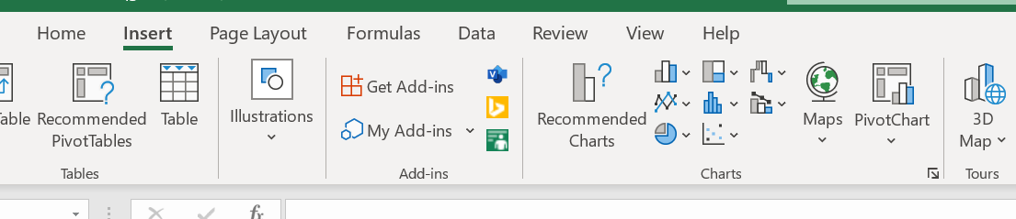
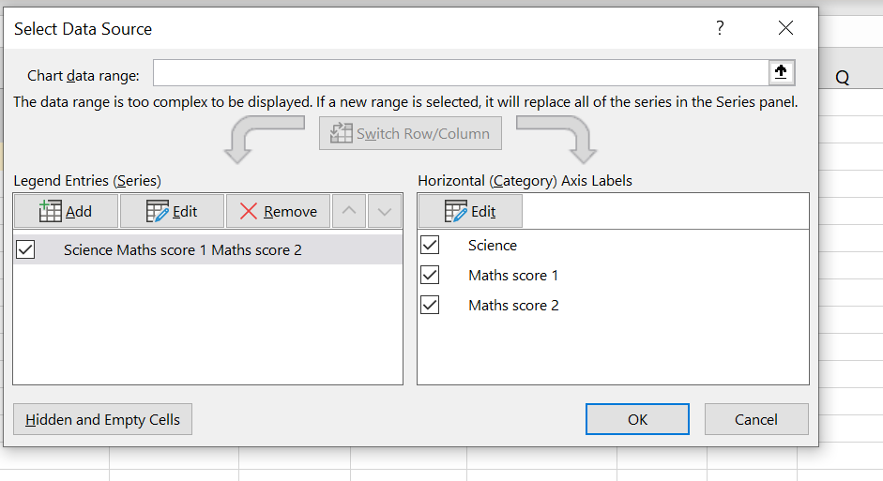
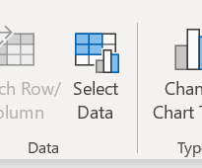
PLOTS
On the insert tab there are a range of different plots to choose from
Click on the graph you want, and specify your data as shown
You can view the example data range by clicking on the example plot provided

Slide 6
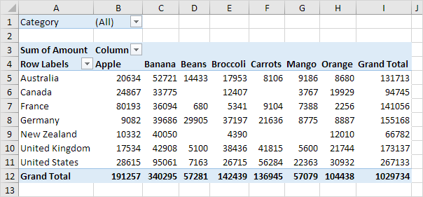
PIVOT TABLES
If you would like to explore how to create a pivot table in excel, please refer to the following guide:
https://www.excel-easy.com/data-analysis/pivot-tables.html
Example of a pivot table

Slide 7


DigData – Data Cleaning
NEXT STEP

Slide 8
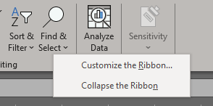
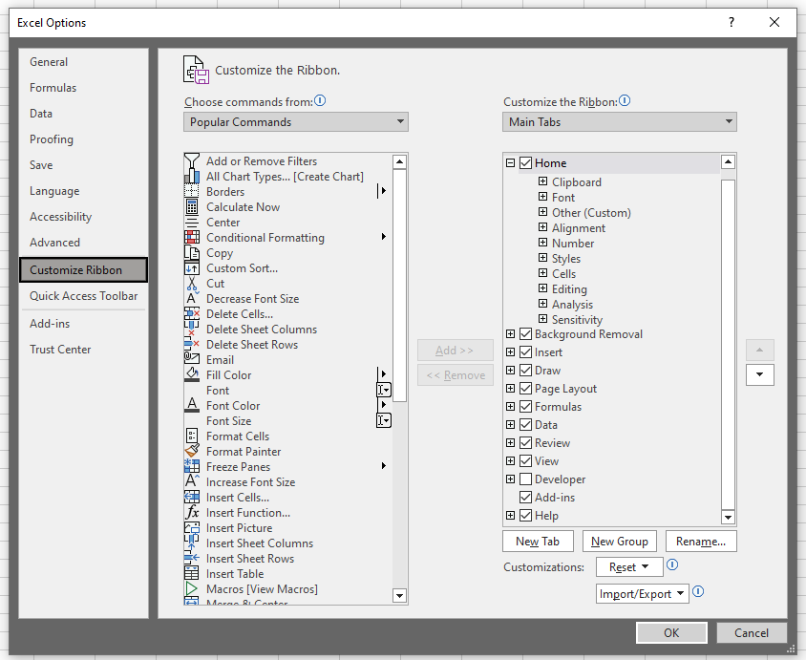
Enable ‘Data’ tab
Right-click in empty space in ribbon
Click ‘Customise the Ribbon’
Ensure the ‘Data’ tab is ticked (circled)
Click ‘OK’
1
2

Slide 9
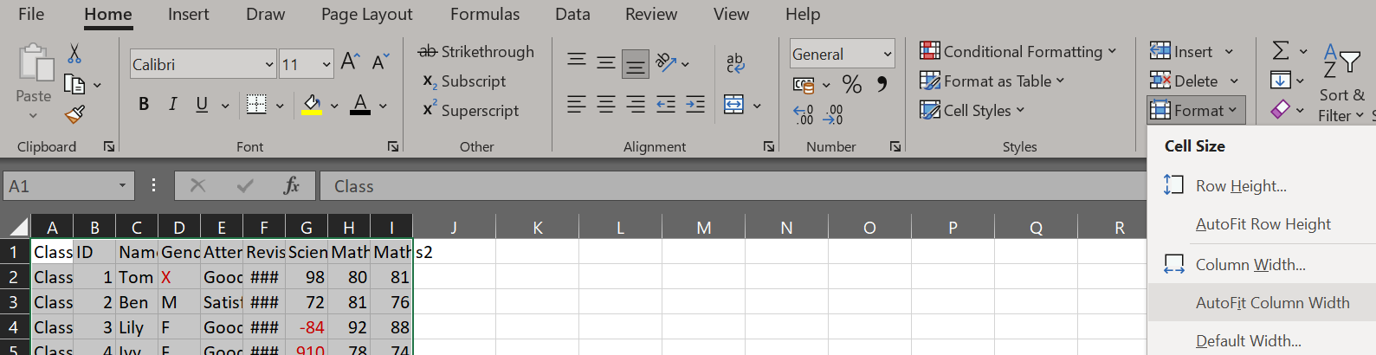
Autofit column width
Highlight all the columns
Format > AutoFit Column Width
1

Slide 10
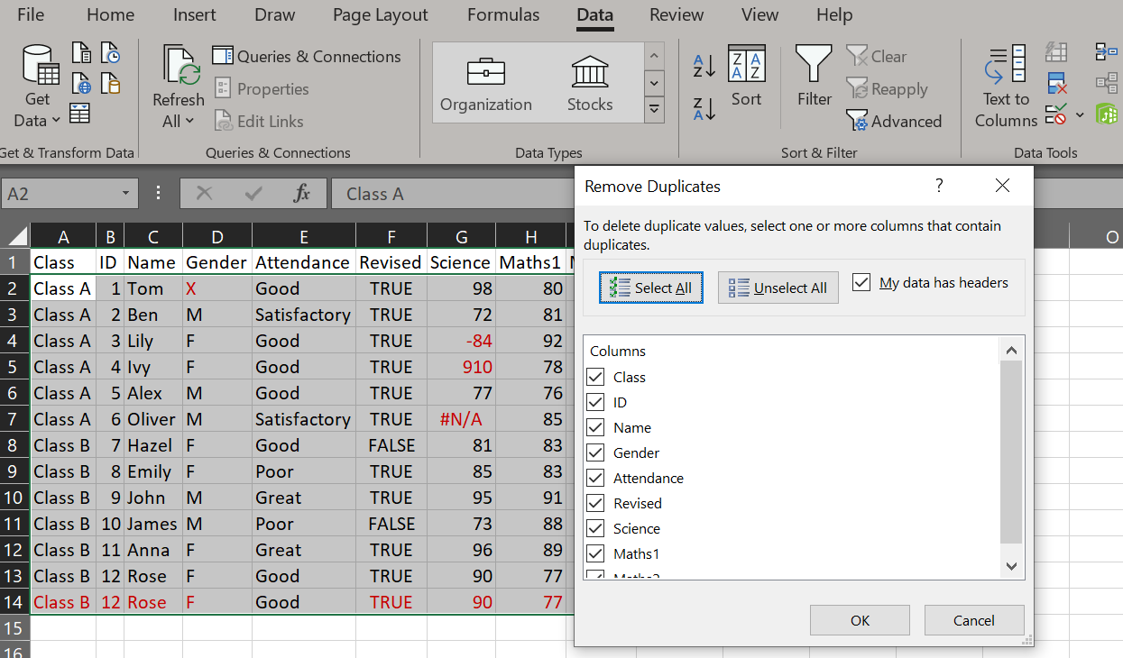
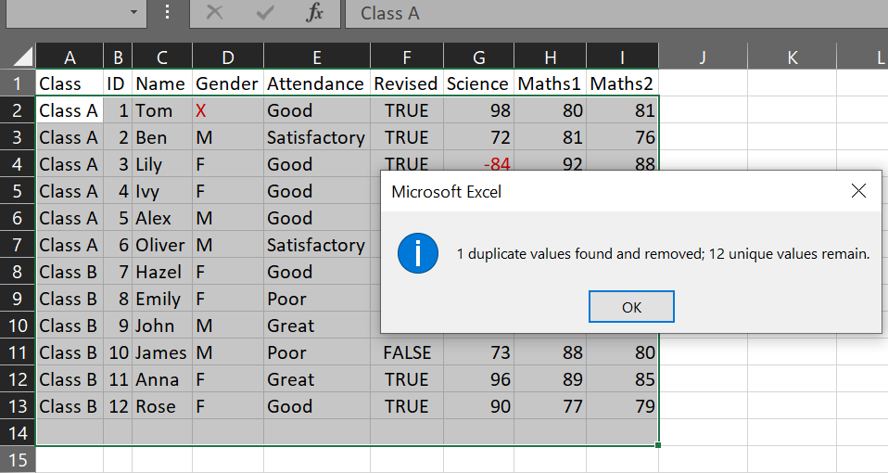
Remove duplicate rows
Go to the Data tab > Remove Duplicates (circled)
Ensure all columns are ticked, then click ‘OK’
1
2

Slide 11
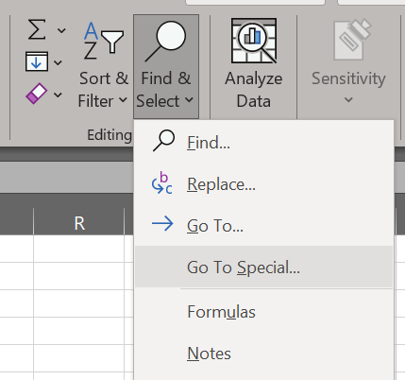
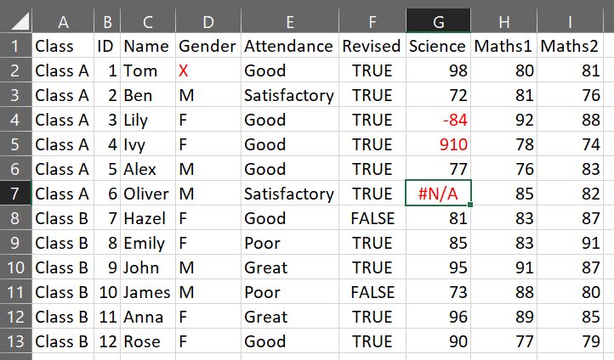
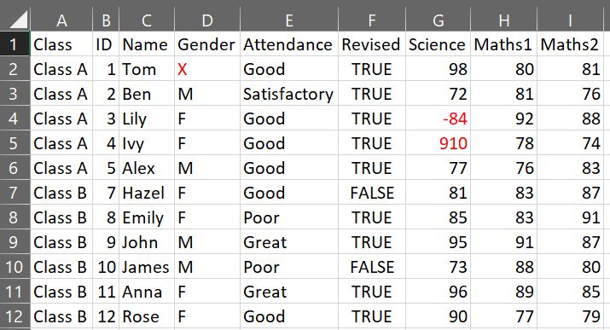
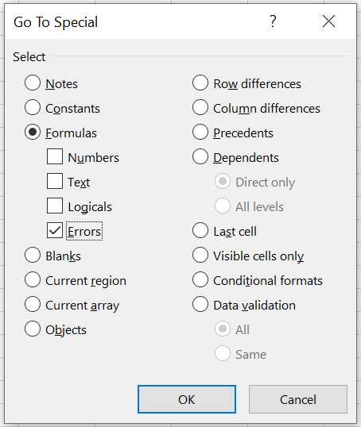
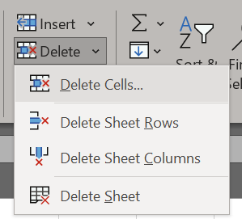
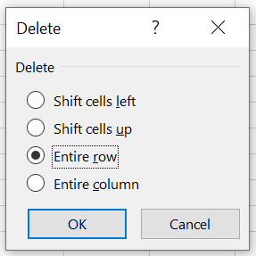
Remove rows with missing values
Home tab > Find & Select > Got To Special > Tick ‘Errors’ only (now the row/s with NA are highlighted)
Home tab > Delete > Delete Cells > Select ‘Entire row’ > OK (now the row/s containing NA is removed)
1
3
6
4
5
2

Slide 12
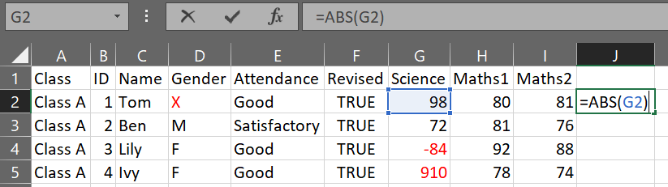
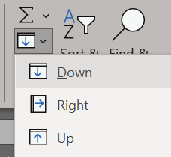
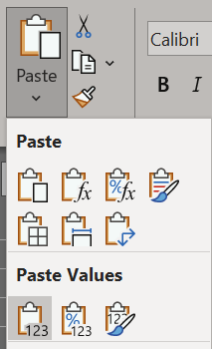
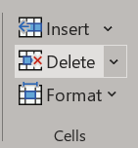
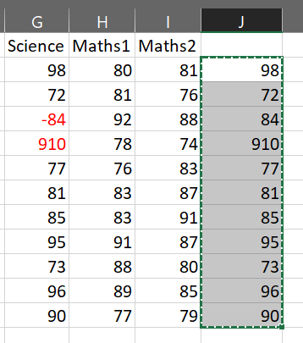
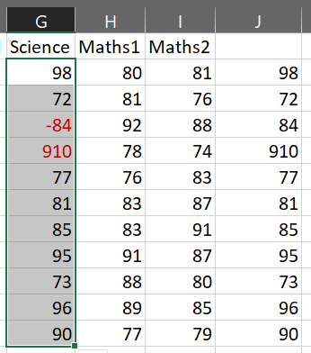
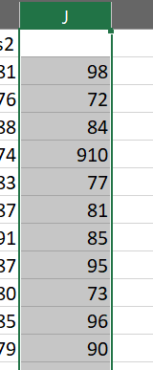
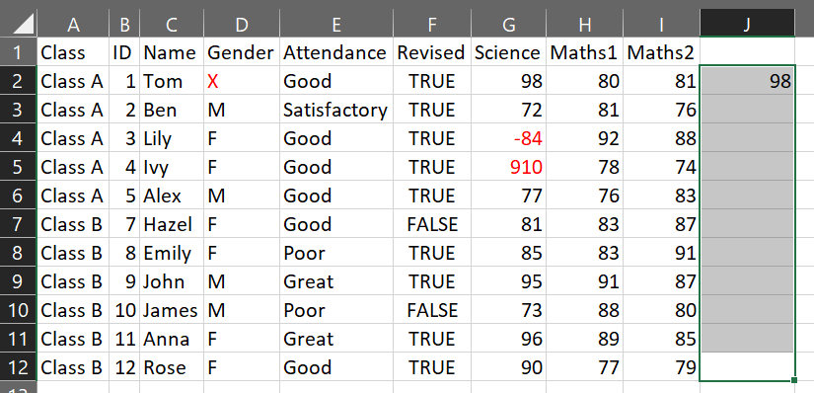
Make all negative values positive
In a new column, select the first value below the heading row
Enter =ABS() and within the backets click/enter the cell value of the first value in the column we’re going to fix
Select the rows in the column you’d like to fill, Home tab > Fill > Down (Tip: you can use Ctrl+D as a shortcut)
Copy the new values, select the column values we’re fixing, Home > Paste > Paste Values, delete new column
1
5
3
7
4
8
2
6

Slide 13
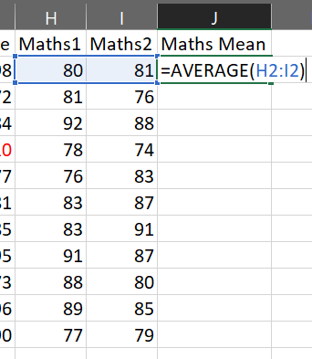
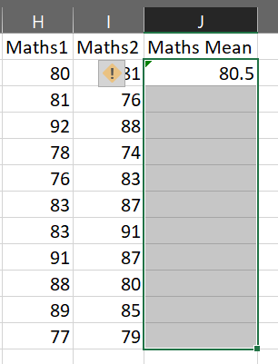
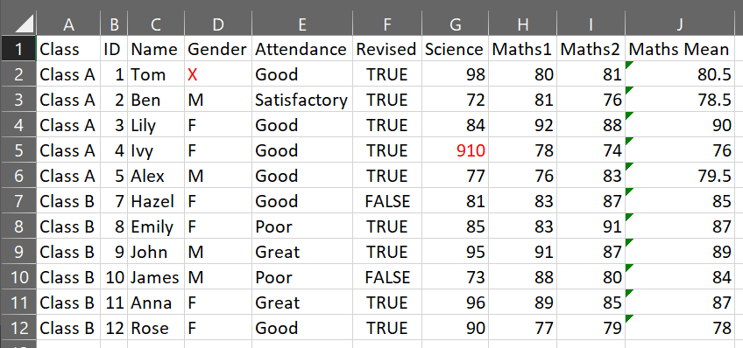
Add row means column
Type the new column heading, select the first cell below
Enter =AVERAGE() and within the backets highlight the cells we’re finding the mean for, then fill down (as previous slide)
You can wrap the above function with ROUND(n) to round the value to n decimal places
1
2
3

Slide 14
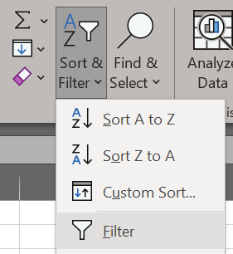
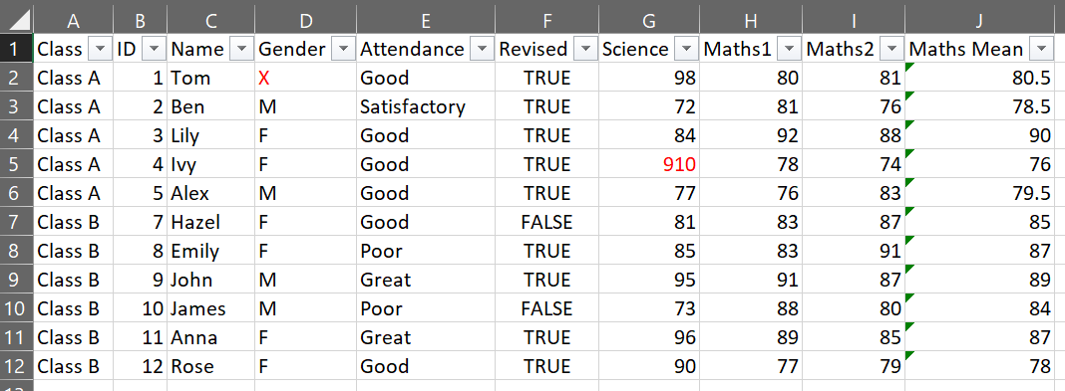
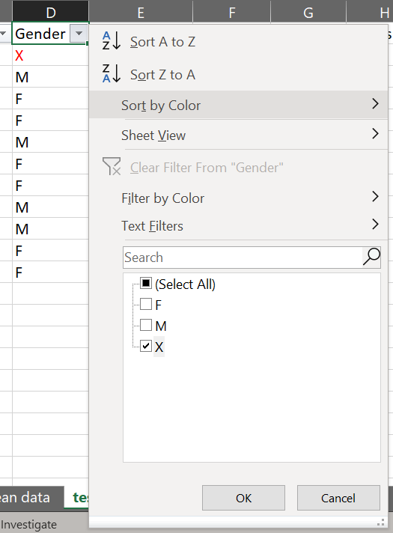
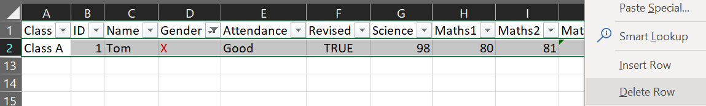
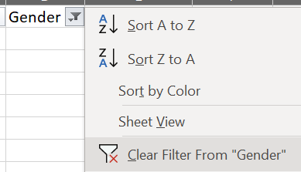
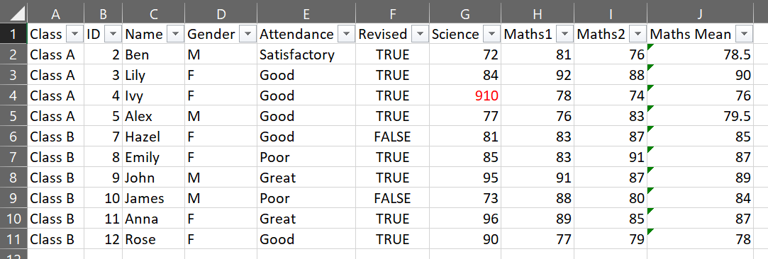
Filter data and remove rows
Select all data, Home > Sort & Filter > Filter (dropdown buttons appear besides heading, autofit column width if desired)
Click dropdown for column to be filtered, tick the values you want to remove > OK
Highlight all rows > right-click > Delete Row > click dropdown button > Clear Filter From “Column”
1
2
3
4
5
6

Slide 15
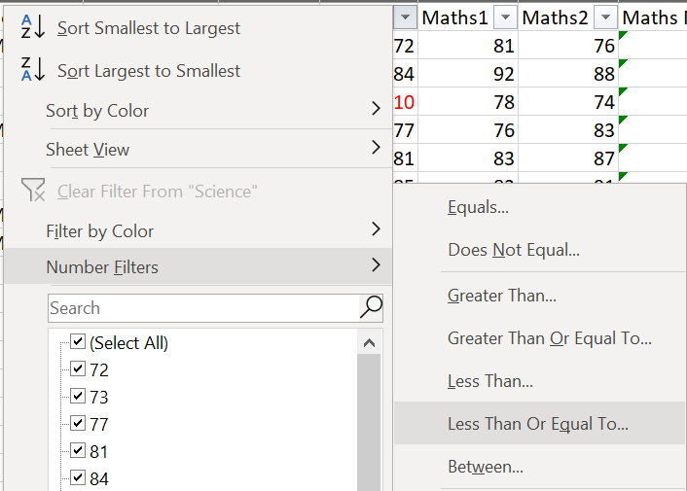
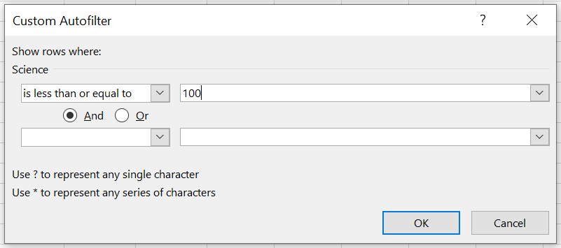
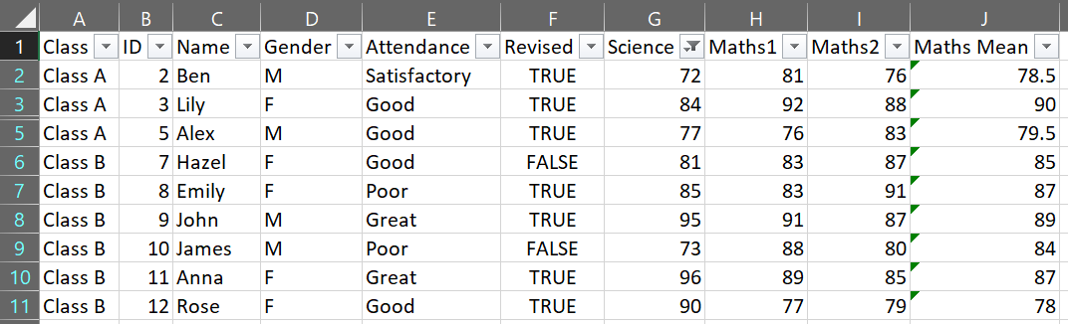
Filter data only
Click dropdown for column to be filtered > Number Filters > Less Than Or Equal To (or whichever filter required)
Enter parameter for filter > OK
In this example, score is out of 100 so we’re filtering the “Science” column to show values <= 100
1
2
4
3

Slide 16
Quick Tips – Excel Shortcuts
Quick select data
To select entire table:
Select the first cell of the data (e.g., A1)
Ctrl+Shift+End
To select column:
Select the first cell of the column
Ctrl+Shift+Down (arrow key)
To select row:
Select the first cell of the row
Ctrl+Shift+Right
Quick fill cells downwards
Highlight the cell you'd like to fill from, and the cells you'd like to fill
Ctrl+D
This shortcut replicates the formula from the first cell across the other highlighted cells
If there is no formula, then the character/number value is duplicated instead
Quick flash fill downwards
Enter a few examples you want as the output
Highlight these example cells, and the cells you'd like to fill
Ctrl+E
This shortcut predicts and automatically fills the highlighted cells according to the identified pattern

Slide 17
End of Slide Deck

